Slide 1
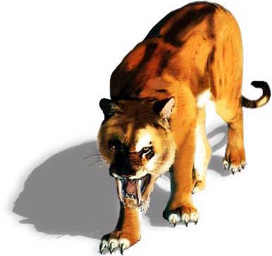
The Saber-Tooth Curriculum
By Harold Benjamin
An Adaptation
By Maria Editha Natividad-Lim

Slide 2
Once there was an intelligent man during the prehistoric era named New-Fist-Hammer-Maker. He was a doer. He produced superior tools and made fire-making techniques more efficient. He was also a thinker. He was always thinking to make life better for himself, his family and his tribe.

Slide 3
One day, as he was watching his children playing, he hit on the concept of a conscious, systematic education. If only his children can do something more than playing for fun, they would have more food, better clothes and safer lives. He wanted BETTER LIVES for his people.

Slide 4
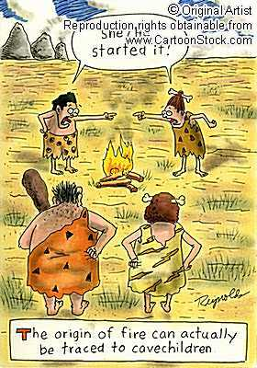
His question was: “What things must we tribesmen know how to do in order to live with full bellies, warm backs and minds free from fear?”

Slide 5
To answer his question, he ran the various activities in his mind. And he discovered three subjects of the first curriculum.
fish-grabbing-with-bare-hands
wooly-horse-clubbing
saber-tooth-tiger-scaring-with-fire

Slide 6
New Fist tested his curriculum on his children first. It was a big success. His children have better and safer lives than the other children who have never been educated systematically.

Slide 7
Gradually, other members of the tribe followed suit and the teaching of fish grabbing, horse-clubbing, and tiger-scaring came more and more to be accepted as the heart of real education.

Slide 8
New Fist and his contemporaries grew old and died. Other men followed their educational ways more and more until at last all the children of the tribe were practiced systematically in the three fundamentals. The tribe prospered. There were enough meat, skins and security.

Slide 9
But conditions have changed. A new ice age was approaching and a great glacier was creeping closer and closer to the headwaters of the creek. The waters grew muddy.

Slide 10
It was now difficult to see the fish in the water. Moreover, after years of fish catching, only the intelligent fish were left and they were hiding under glacial boulders.

Slide 11
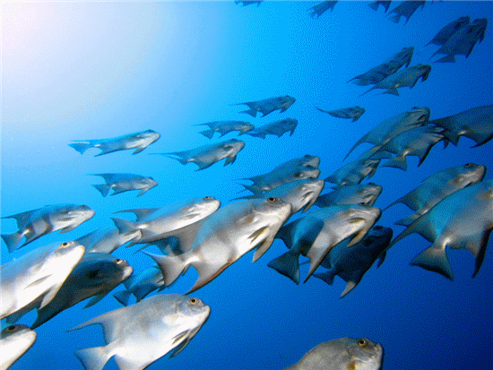
No matter how good a man’s fish-grabbing education had been, he could not grab fish when he could not find fish to grab.

Slide 12
The melting waters also made wide marshes along the banks of the creek. Horses did not like the wet land so they all went far east to the dry, open plains. In their place came antelopes who were shy and speedy and have a keen scent for danger that no one can go near them enough to club them.

Slide 13
Finally, to complete the disruption of the tribe life, the new dampness in the air gave saber-toothed tigers pneumonia and they all died. With no more tigers to scare, the best tiger-scaring techniques became only academic exercises, unnecessary for tribal security

Slide 14
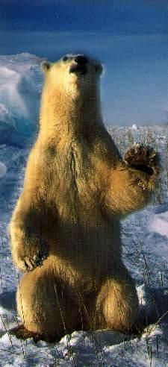
With advancing ice sheets came the ferocious glacial bears which were not afraid of fire, which walked trails night and day and which could not be driven by the most advanced methods developed in the tiger-scaring courses in school.

Slide 15
The tribe was now in a very difficult situation. There was no fish for food, no hides for clothing and no security from hairy death. Adjustments must be made at once if the tribe was not to become extinct.

Slide 16
Fortunately, there were men of the old New-Fist breed who had the ability to do and had the daring to think. They started to invent new tools: fishing nets, antelope snares and digging bear pits.

Slide 17
The few thoughtful men planned a the following curriculum revisions:
fish-net making and using
antelope-snare construction
bear-catching and killing.

Slide 18
But when it was brought up in the tribal meeting, most of the tribe and particularly the wise old men who controlled the school smiled indulgently and said, “That wouldn’t be education”.
“Why wouldn’t it be?” the radicals asked.

Slide 19
The old men replied: “It would be mere training, The 3 standard cultural subjects are enough. We can’t add these fads and frills. We need to give our young people a more thorough grounding in the fundamentals. Our graduates nowadays cannot even excel in these.”

Slide 20
The radicals were furious. “What is the point of trying to catch fish with bare hands when it just can’t be done anymore? How can a boy learn to club horses when there are no more horses? Why should children try to scare tigers with fire when the tigers are dead and gone?

Slide 21
The wise old men said with kindly smiles. “We don’t teach fish grabbing to grab fish; we teach it to develop a generalized agility which can never be developed by mere training.

Slide 22
We don’t teach horse-clubbing to club horses; we teach it to develop a generalized strength in the learner which he never can get from a specialized thing as antelope-snare setting.

Slide 23
We don’t teach tiger-scaring to scare tigers; we teach it for the purpose of giving the noble courage which carries over into all the affairs of life and which can never come from bear killing

Slide 24
One radical made a last protest: “You have to admit that times have changed. Couldn’t you please try these other more up-to-date activities? Maybe they have some educational value after all.”

Slide 25
The wise old men became indignant.
Their kindly smiles faded.

Slide 26
“If you were educated yourself, you will realize that the essence of education is timelessness. It endures through changing conditions. You must know that there are some eternal verities, and the saber-tooth curriculum is one of them.

Slide 27
THE END

